Slide 1
Nuraghe Santu Antine
Bronze Age Sardinia Megastructure

Slide 2
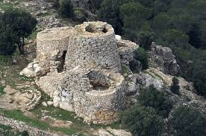
Background Info
Nuraghe- the main type of ancient megalithic edifice found in Sardinia, developed during the Nuragic Age between 1900 and 730 BCE
Left behind by the Nuragic civilization
Some 7,000 known Nuraghe in existence
Unknown function

Slide 3
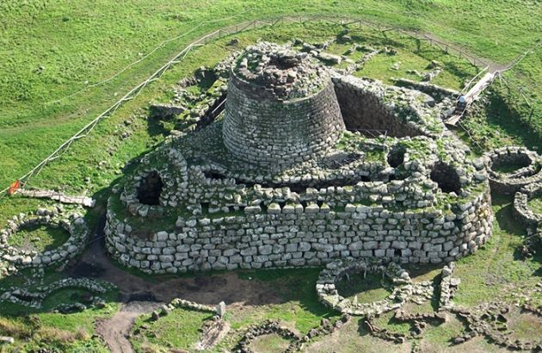
Nuraghe Santu Antine
Largest nuraghe with 3 floors
Oldest parts are from 15th century BCE
Arched corridors
Nuragic village nearby
Later Roman settlement

Slide 4
Excavation History
First known documentation is in 1774
First excavation 1933 by Antonio Taramelli
It is considered by many scholars to be the best among the nuraghi preserved in Sardinia, due to its grandiosity of size, harmony of structure, complexity and evidence of the architectural elements. The reliefs of the Lamarmora, from the first half of the last century, were completed by the general excavation of the building recently completed (1934-1935).
Restoration efforts in 1965-1966
Wrapped up in 2009

Slide 5
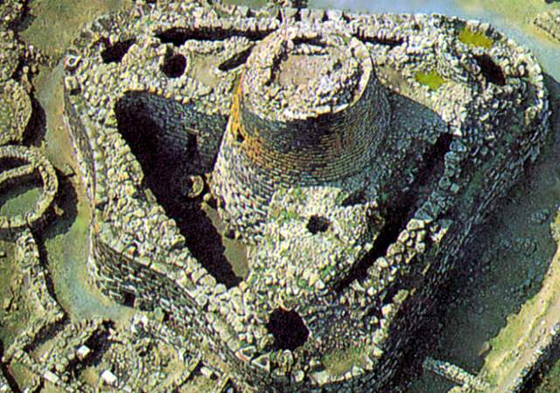
Importance
Emblematic of Sardinia and its history
Highlight other Mediterranean cultures
Lots of potential future research

Slide 6
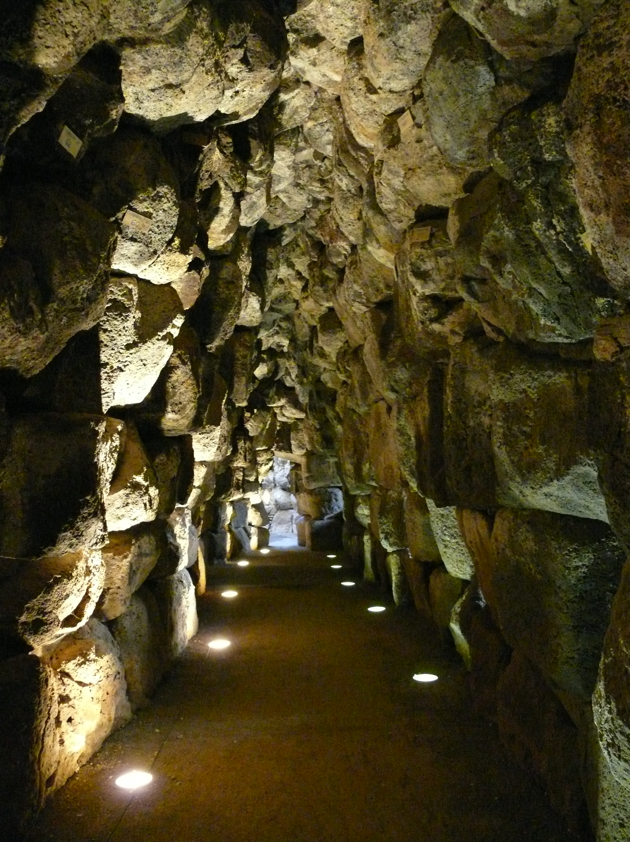
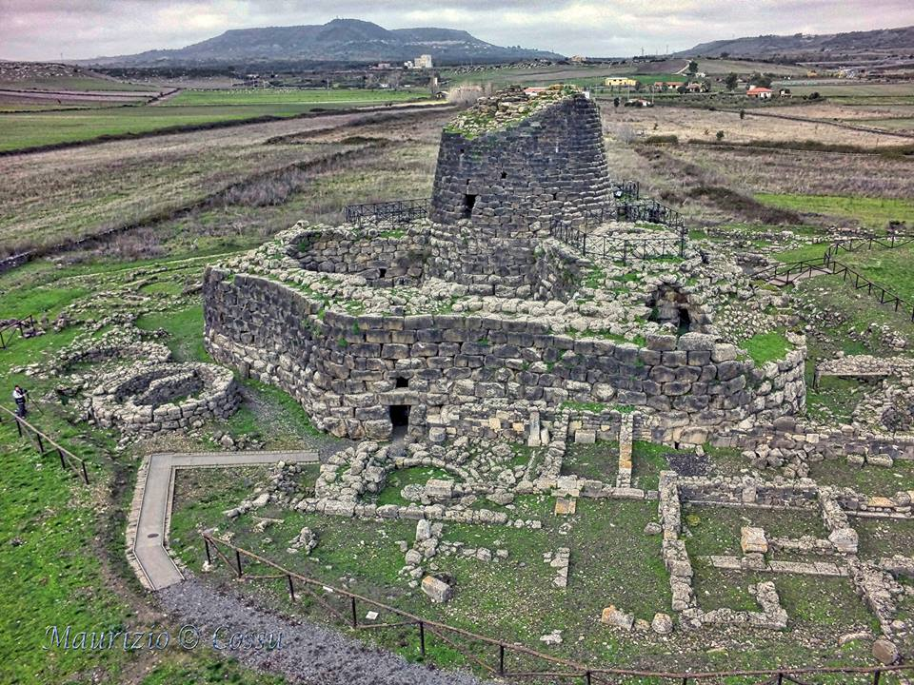
Pictures

Slide 7
Bibliography
https://www.nuraghesantuantine.it/?modulo=home
Il Nuraghe Santu Antine, Ercole Contu, 1988.
Oxford English Dictionary (online ed.)

